Slide 1

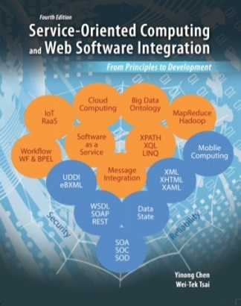
The Final Lecture Every End is a New Beginning
CSE 445 / 598
Distributed Software Development
Dr. Yinong Chen
https://myasucourses.asu.edu/

Slide 2
Lecture Outline
MVC Web Application Architecture
Course Summary
Outlook of the Next SOC Course and Beyond
A new software development paradigm consists of many concepts, methods, and technologies.
We have covered many of them, but they are a fraction of what can be covered in Service-Oriented Computing.
We try to cover more in the next course

Slide 3
Review: ASP .Net Web Application Architecture
ASP .Net places the presentation layer files (.aspx) and the controller file (.aspx.cs) together.
The advantages
Related items are placed together.
It matches OO and is easy to develop based on OO principles.
The disadvantages:
Mix two tiers together (View and Controller) and add dependency.
ViewState is not well supported in server farms/cloud computing
MyWebApp root
Global.asax
Web.config
.aspx & aspx.cs
files
.ascx & ascx.cs
files
.aspx & aspx.cs
files
.ascx & ascx.cs
files
.aspx & aspx.cs
files
.ascx & ascx.cs
files
User defined dir
App_Data
bin
.aspx & aspx.cs
files
.dll
file
.aspx & aspx.cs
files
XML file
.aspx
files
.aspx & aspx.cs
files
Web
.config
DB file
.exe
file
.aspx
files
.aspx
files
XML file
.aspx
files
.aspx
files
XML file
.aspx
files

Slide 4
MVC as an Architecture Pattern
Hardware Patterns
Software Patters
Patterns
Architecture Patterns (Client-server, tiered, MVC)
Computing Patterns (Computing paradigms)
Design Patterns (Creational, structural, behavioral, and currency patterns)
The MVC pattern was originally formulated in the late 1970s by Trygve Reenskaug at Xerox PARC, as part of the Smalltalk. [http://en.wikipedia.org/wiki/Model%E2%80%93view%E2%80%93controller].
In MVC, the system is divided into three groups of components:
Model: contains the components representing data and application logic for data processing;
View: Display the results from model;
Controller: It is between the Model and View. It takes input from the user, provides handlers of the inputs (simple processing), and let the model to process more complex functions.

Slide 5

Three-Tier, ASP .Net Web Form, and MVC
Three-Tier
ASP .Net Web Forms
MVC
Client Browser page
Client Browser page
Client Browser page
View (html):
What is sent to
the client browser
Java
Script calls
Presentation
Layer (GUI)
ASPX.aspx GUI and
Server Controls
Controller: Handlers of inputs
Application
Processing Layer
Local Modules
Web Services
Model:
Conceptual Model of Data
Data Management Layer
Database / files
States and Data Sources
Control Flow / Method Call
Data / Event

Slide 6
J2EE’s MVC Architecture
Client Browser page
View:
What is sent to client browser
JSP Pages
Controller: Servlet
Java EE Server
Model:
Enterprise Java Bean (EJB)
States and Data Sources
Enterprise Information System Database Server

Slide 7
MVC in ASP .Net: A Four Tier Architecture with loosely coupling among the tiers
View: The files that will generate the HTML files for client: the .aspx pages without .cs files
Controller: The aspx.cs files
Other controls and Computing Components and Services
Model: Objects that are process domain data for business logic
States and Data Sources

Slide 8
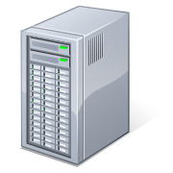
Different Computing Models
Browser refresh
In ASP .Net Web Forms:
The entire ASPX page is a unit.
ASP .Net Web Form uses postback
Page refreshed
A mouse click
Server Page
ASU Engineering Building
Server postbacks a new HTML page
699 S Mill Avenue
ASP .Net MVC page is not one unit.
It uses JavaScript calls similar to AJAX.
JavaScript calls are harder to write.
ASP .Net MVC makes it easier.
Client Machine
Server
Browser
Web server / Web services
Server side
request processing
①
HttpRequest
④
⑦
②
JavaScript
call
③
Data
processing
Update
JavaScript
Data
Data
request
XMLHttpRequest
⑥
⑤
XML Data post back in the same page
Database
XMLHttpRequest
Callback()
Application workflow / processing

Slide 9
View State and Hidden Fields
We can explicitly use View State (dictionary array) to store state information (Chapter 3)
Some of the server controls, such a Gridview, use View State (hidden field), so that the information user entered will stay after a user browse away from the page and comes back to the same page.
The View State information is encrypted. A server farm may use a different VM to deal with the page when the page return. We must configure to use <machineKey> in machine.config as the specifies the validationKey for encryption/decryption of View State information.
In .Net Framework 4 and later, you can disable View State in Web.config by adding an attribute, e.g.: <asp:LoginView ID="HeadLoginView" runat="server" EnableViewState="false">

Slide 10
MVC Model
The entire page is no longer treated as one unit.
Each page is an HTML page, with a collection of JavaScrypt calls to communicate with the server.
No need to page-postback the entire page, and thus, each change will be sent back to the browser whenever the change happened.
ASP .Net Web Forms cannot postback whenever a change is made, as it may override the textbox and other data the user is entering.
Analogy: In computer organization cache design:
Write-through: any cache change is write to memory immediately.
Write-back: change will not go back to memory until the cache needs to be replaced.

Slide 11
Model, View, and Controller in ASP .Net
View: A directory contains the components that will generate the application's display (GUI) or the presentation layer of the application (output part).
Controller: A directory contains the components that handle user inputs, work with the model, and ultimately select a view to render the displays in GUI.
Model: A directory contains objects that that implement the part of the application logic related to the application's data domain. Often, model objects retrieve and store model state in a date sets, files, and database.

Slide 12
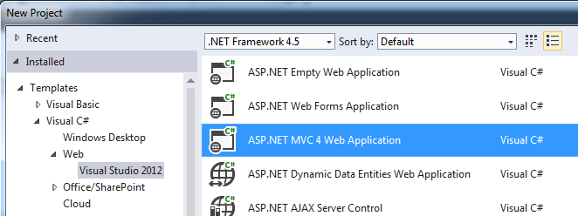
ASP .Net MVC Architecture
Reading: Text Chapter 5, Section 5.7
ASP .Net offers MVC as an alternative project template;
It is available for Web Apps, Mobile Apps, and Cloud Apps, without using any View State!
Once selected the MVC template, the main components of the application will be organized in three directories: Models, Views, and Controllers.

Slide 13
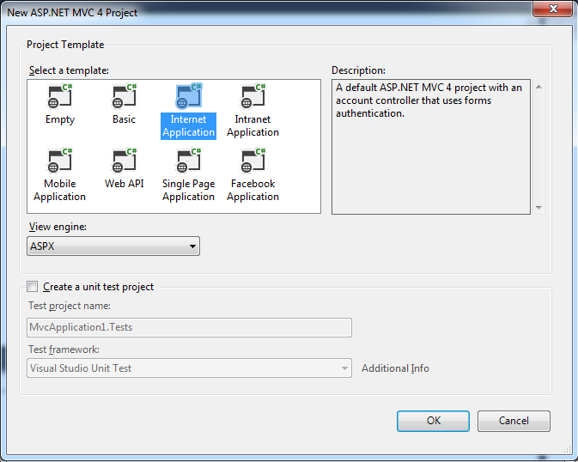
MVC can be applied for developing different apps

Slide 14
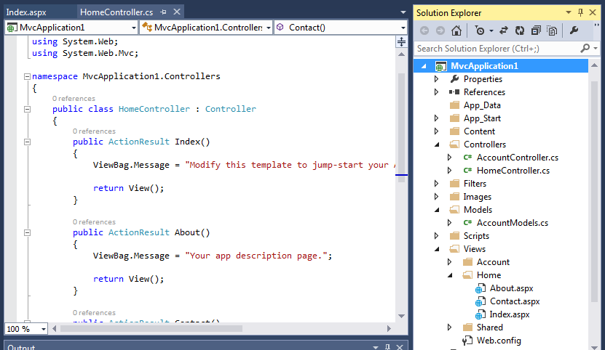
A New MVC Project: Organized Differently
.aspx.cs files, are moved to here
Put any business logic not related I/O are here
.aspx files, without .aspx.cs files

Slide 15
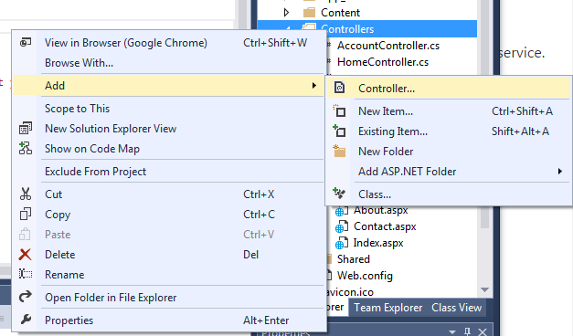
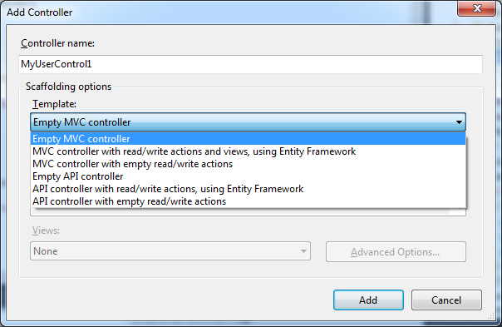
Add my Controller
Right click

Slide 16
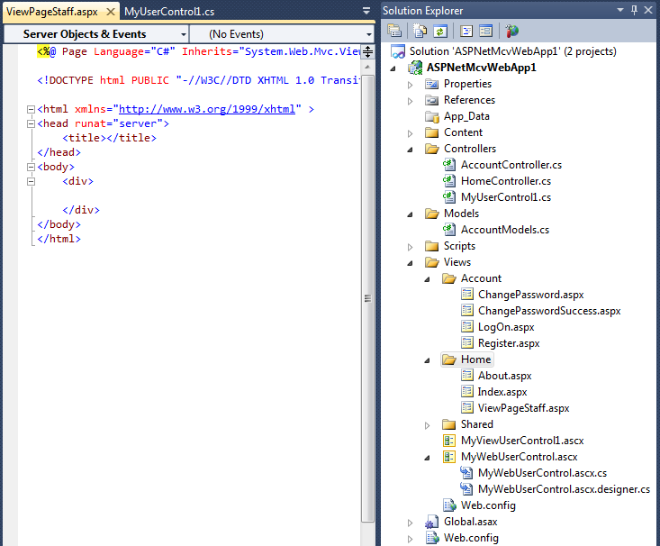
New Items are Added to the MVC Project
MVC user control’s .cs file is added separately here.
A View Page is added here
A MVC user control. Only .ascx file is added
A traditional User control with both .ascx and .cs files

Slide 17
How are Browser and Controller Connected?
In ASP .Net, the .aspx files and .aspx.cs files are placed together in the same folder. The links are implicit. You must click the buttons to create the implicit links. It works because the two pages are tied together.
In MVC, the links are explicit.
Each View component (.aspx file) in browser contains a list of JavaScript calls.
The Controller of the component contains the methods to be called. View page and .cs page can be completely separated.

Slide 18
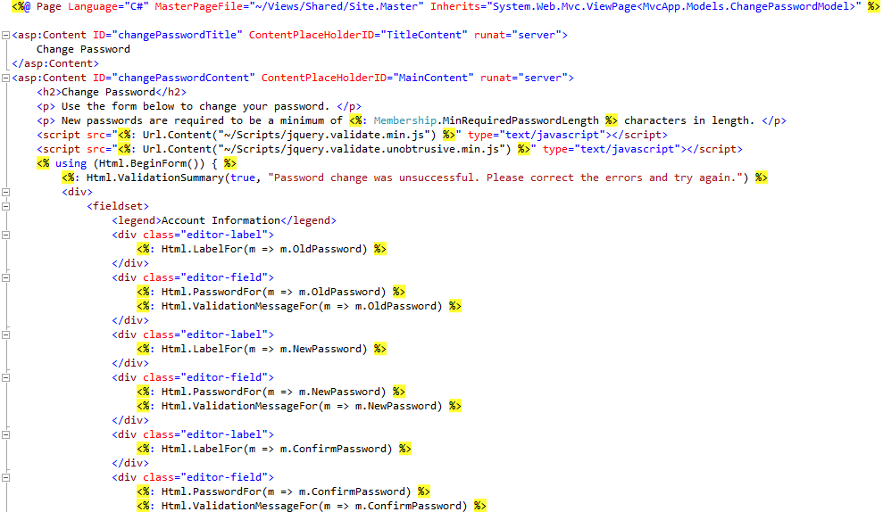
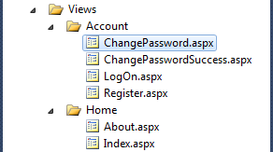
ChangePassword in ChangePassword.aspx, making JS calls

Slide 19

ChangePassword method in AccountController.cs
To be called from JavaScript
// POST: /Account/ChangePassword
[Authorize]
[HttpPost]
public ActionResult ChangePassword(ChangePasswordModel model) {
if (ModelState.IsValid) {
// ChangePassword will throw an exception rather than return false in certain failure scenarios.
bool changePasswordSucceeded;
try {
MembershipUser currentUser = Membership.GetUser(User.Identity.Name, true /* userIsOnline */);
changePasswordSucceeded = currentUser.ChangePassword(model.OldPassword, model.NewPassword);
}
catch (Exception){
changePasswordSucceeded = false;
}
if (changePasswordSucceeded) {
return RedirectToAction("ChangePasswordSuccess");
}
else {
ModelState.AddModelError("", "The current password is incorrect or the new password is invalid.");
}
}
// If we got this far, something failed, redisplay form
return View(model);
}

Slide 20

ChangePassword method in AccountModels.cs
public bool ChangePassword(string userName, string oldPassword, string newPassword) {
if (String.IsNullOrEmpty(userName)) throw new ArgumentException("Value cannot be null or empty.", "userName");
if (String.IsNullOrEmpty(oldPassword)) throw new ArgumentException("Value cannot be null or empty.", "oldPassword");
if (String.IsNullOrEmpty(newPassword)) throw new ArgumentException("Value cannot be null or empty.", "newPassword");
// The underlying ChangePassword() will throw an exception rather
// than return false in certain failure scenarios.
try {
MembershipUser currentUser = _provider.GetUser(userName, true /* userIsOnline */);
return currentUser.ChangePassword(oldPassword, newPassword);
}
catch (ArgumentException) {
return false;
}
catch (MembershipPasswordException) {
return false;
}
}
Access database

Slide 21
Automatically Generate Unit Test
http://msdn.microsoft.com/en-us/library/dd410597%28v=vs.100%29.aspx
In the project, right-click the Controllers folder, click Add, and then click Class.
In the Name text box, type MapsControllerTest.
Click Add.
namespace MvcBasicWalkthrough.Tests.Controllers {
[TestClass]
public class MapsControllerTest {
[TestMethod] public void ViewMaps() {
// Arrange
MapsController controller = new MapsController();
// Act
ViewResult result = controller.ViewMaps() as ViewResult;
// Assert
Assert.IsNotNull(result);
} } }

Slide 22
Benefits of MVC Architecture
The loosely coupled feature (compared with ASP .Net architecture) among the tiers in Views, Models, and Controllers:
Allow team members to develop different parts of the application with reduced interactions;
The template can generate unit tests by automatically adding mock objects (simulated objects) that mimic the behavior of other objects in controlled ways in the application;
The restricted use of the view state, page postback, and related server controls, such as Gridview, allows the framework to render the XHTML page less dependent on the server features;
The MVC applications are more friendly with URI-based access used on RESTful services, the feed data formats, and cloud computing environment (CSE446).

Slide 23
Lecture Outline
MVC Architecture
Course Summary
Outlook of the Next SOC Course and Beyond

Slide 24
Summary of the Course: Chapters 1 - 2
Introduction and Overview of the Course (4 lectures)
Distributed computing
Distributed software architecture
Service-oriented computing concepts
Service-oriented software development
Research and trend in service-oriented computing (for 598 only)
Multithreading and Distributed Computing (5 lectures)
Sequential versus parallel computing
Sharing, synchronization, coordination
Event-driven software development
Performance improvement of multithreading using many core processors
Java-based development and C#-based development

Slide 25
Summary of the Course: Chapters 3 - 4
Essentials in SOC Software Development (4 lectures)
Service development (in ASP .Net and in WCF)
Service hosting and service directory
Basic service client (Web application) development (ASP .Net)
Java-based service and application development
XML and Related Technologies (4 lectures)
XML Basics
XML Document Type Definition (DTD) and XML Schema
XML processing: different readers and writer
XML Style and Transformation

Slide 26
Summary of the Course: Chapters 5 - 7
Web Application and Data Management (4 lectures)
Web computing models: client side and server side
Web application architecture (ASP .Net)
Web application components: Web controls and user controls
Web application components: Global, DLL, and Cookies
Web data management: Session state, application state, XML file
Security and Reliability (4 lectures)
Security and reliability concepts
Forms security
IIS security, Windows security, and SSL
Encryption and decryption service and WS-ReliableMessaging
7. Presentation and View (3 lectures)
Dynamic graphics generation
Phone apps with Silverlight and animation
MVC

Slide 27
Outlook of the Next Course
CSE446/598
Software Integration and Engineering

Slide 28
Thirty years ago,
object-oriented computing emerges
Ten year later,
Everything becomes objet-oriented,
from industry applications to academic classes
Twelve years ago,
service-oriented computing emerges
Six years later,
We have one SOC course at ASU: CSE445
Ten year later, we have two SOC courses at ASU: CSE445 and CSE446
We have more ahead of us in this new paradigm
What Next?

Slide 29
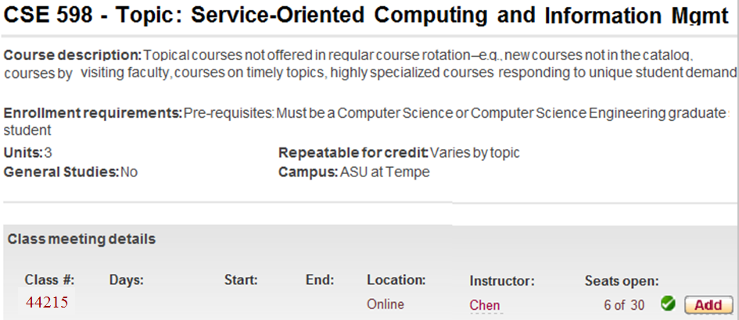
SOC-II for Graduate Students
The new course was initially developed and offered in Summer 2010 and Summer 2011!

Slide 30
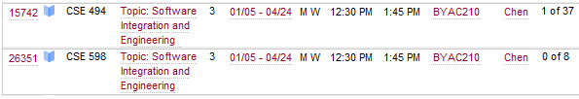
The Graduate Course is Extended to Undergraduate
Software Engineering Concentration Course Map
(CSE 446)
CSE464/598 Software Quality Assurance and Testing
CSE460
Software Analysis and Design
First offer:
Fall 2011 and now every fall
CSE360
Introduction to Software Engineering
[7th semester]
[7th or 8th semester]
CSE446/598 Software Integration and Engineering
[6th semester]
CSE445
Distributed Software Development
First offer:
Spring 2012
and now every spring
[7th semester]
[7th or 8th semester]

Slide 31
From CSE445 (SOC-I) to CSE446 (SOC-II)
CSE445/598
Language-based SOC software development;
Must have strong CS background and object-oriented programming skill;
Largely bottom-up approach
CSE446/598: Emphasis on software integration
Less emphasis on language-based development
Workflow composition at component level
Resource-oriented (REST) and data-driven approaches
Data services: Database interfacing, Big Data, ontology and, Cloud computing

Slide 32

One Text for Two Courses
Part I Distributed Service-Oriented Software Development and Web Data Management
Chapter 1 Introduction to Distributed Service-Oriented Computing
Chapter 2 Distributed Computing with Multithreading
Chapter 3 Essentials in Service-Oriented Software Development
Chapter 4 XML Data Representation and Processing
Chapter 5 Web Application and Data Management
Chapter 6 Dependability of Service-Oriented Software
Part II Advanced Service-Oriented Computing and System Integration
Chapter 7 Service-Oriented and REST Architecture
Chapter 8 Service-Oriented Software Development and Integration
Chapter 9 Internet of Things and Robot as a Service
Chapter 10 Interfacing Service-Oriented Software with Databases
Chapter 11 Big Data and Ontology Systems
Chapter 12 Service-Oriented Application Architecture
Chapter 13 A Mini Walkthrough of Service-Oriented Software Development
Chapter 14 Cloud Computing and Software as a Service (SaaS)
CSE445
CSE446

Slide 33
Service-Oriented Computing & Web Software Integration
Big Data
IoT RaaS
Cloud
Computing
MapReduce Hadoop
CSE446/598
Software as a Service
XPATH
XQL
LINQ
Mobile
Computing
Workflow
UDDI eBXML
Message Integration
XML
XHTML
XAML
WSDL
SOAP
REST
Data State
CSE445/598
Security
SOA
SOC
SOD
Reliability

Slide 34
Programming .Net Remoting and REST in WCF
SOC Software Development Environment | Platform- independent Web service | WS-Security WS-Reliability | Distributed transactions | Platform- dependent service | RESTful service
ASP .Net | X
.Net Remoting |  |  |  | X
Enterprise Services |  |  | X
WSE |  | X | X
WCF | X | X | X | X | X

Slide 35
Creating a Platform-Dependent (.Net Remoting) Service
.Net client access the services in C# interface
Self-Hosting
Define an interface
with method signatures
Define a class as a service with methods
Define a .Net application class to host the service
in console application template

Slide 36
RSS as XML in RESTful Services

Slide 37
Atom as XML in RESTful Services

Slide 38
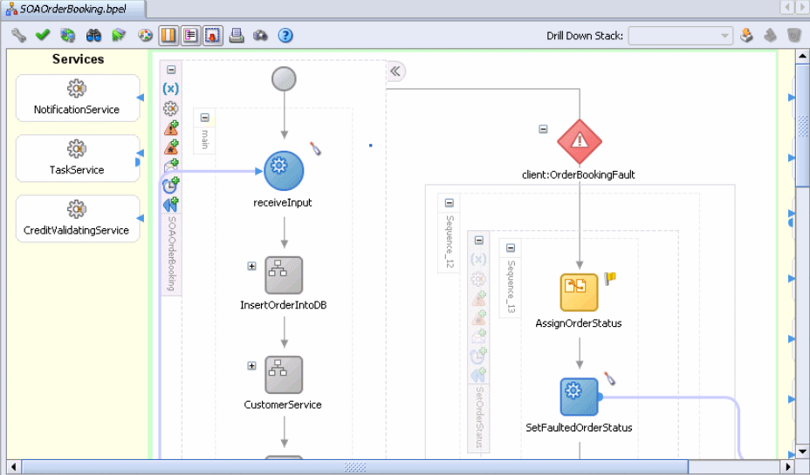
Architecture-Driven Development:
Oracle’ SOA Suite for BPEL Applications

Slide 39
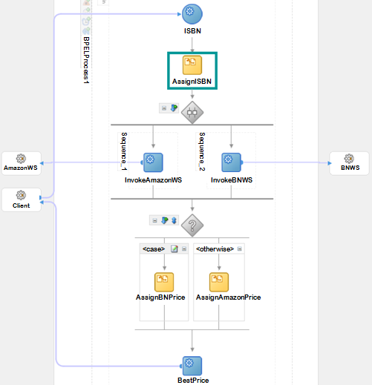
BPEL Workflow-Based Software Development
Enter WS URL:
Enter WS URL:

Slide 40
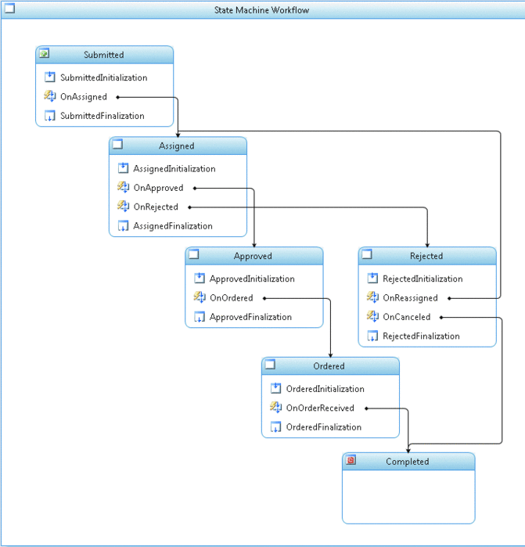
Workflow Foundation Implementing flowchart
User submits request
Submitted
Assigned
approve
Approved
Rejected
reassign
cancel
Ordered
Completed

Slide 41
Message-Based Integration and ESB
http://venus.eas.asu.edu/WSRepository/Services/Messenger/Service.svc
Message Board: One-to-Many with subscription
Message Queue: One-to-One with off-line delivery
Messaging services
publish
subscribe
Client
Web
Client
Client
Board for
topics
Client
deliver
send
Client
Phone
Client
Message Queue
deliver
Create board
Create queue
Administrator

Slide 42
LINQ: Language Integrated Query
OO languages
C#
VB
C++
X
. . .
LINQ addition
Standard constructs
Standard constructs
Standard constructs
Standard constructs
Uniformed data objects
In-memory objects
Different data entities
ADO .Net data entities
Relational database records
XML nodes

Slide 43
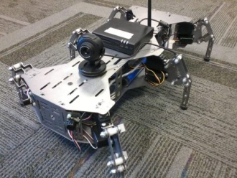
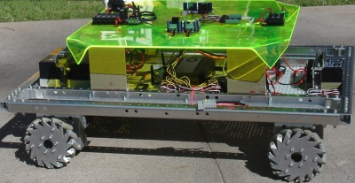

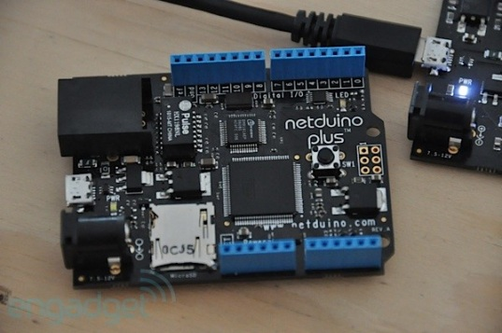
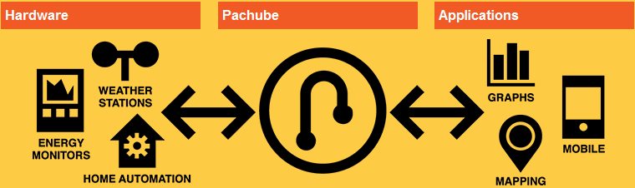
Internet of Things and Robot as a Service
Software as a Service
Platform as a Service
Infrastructure as a Service
X as a Service
Robot as a Service
Cyber Physical Devices
Device as a Service
Cloud Computing Environment
Service Interface in HTTP, URI, REST. WSDL, SOAP, etc.
User data
Server
User hardware
API
Client application

Slide 44
From Big Data Concepts to Domains of Study
Data Processing
Analytics
Volume
Velocity
Data
Collection
Data-App
Integration
Variety
Value
Volatile
Variability
Veracity
Data Store
Management
Concepts
Infrastructure and Facilities

Slide 45
Semantic Web Language Stack
Semantic Web Human User interface
Semantic Web Programmer’s interface
Reasoning/Datamining
Data Access
Ontology Instance / Big Data
Ontology Vocabulary
Ontology Languages: RDF, RDFS, OWL
XML and XML Schema
URI
Unicode
Semantic Web Development Environment

Slide 46
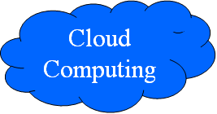
Web 2.0, Web 3.0, and Cloud Computing
Intelligent Web with Web 2.0 + Web 3.0 composition
Web 2.0
mashup
SOC-based Web 2.0
UDDI, WSDL, SOAP
Dynamic
Web 3.0
mashup
WWW
URI, HTML, HTTP
Semantics-based
Web 3.0
RDF, RDFS, OWL
Static
Syntax
Semantics

Slide 47
Cloud Environments to be Discussed
Google App Engine: Free account with limited resources; Java and Python based; Supported by Google APIs and services;
Microsoft Windows Azure: C# and .Net based; Supported by Microsoft CRM (Customer Relationship Management), ERP (Enterprise Resource Planning ), and Web services;
Oracle Exalogic Elastic Cloud in a Box: From hardware to software in a box. Designed to provide the an environment for enterprise Java applications and Java-based infrastructure; It scales horizontally with no degradation of system performance as the size of the cloud increases.
Saleforce.com: Large number of services in CRM and ERP;
Amazon Elastic Compute Cloud: Large number of services in e-commerce, supported by development platform and infrastructure.

